Slide 1
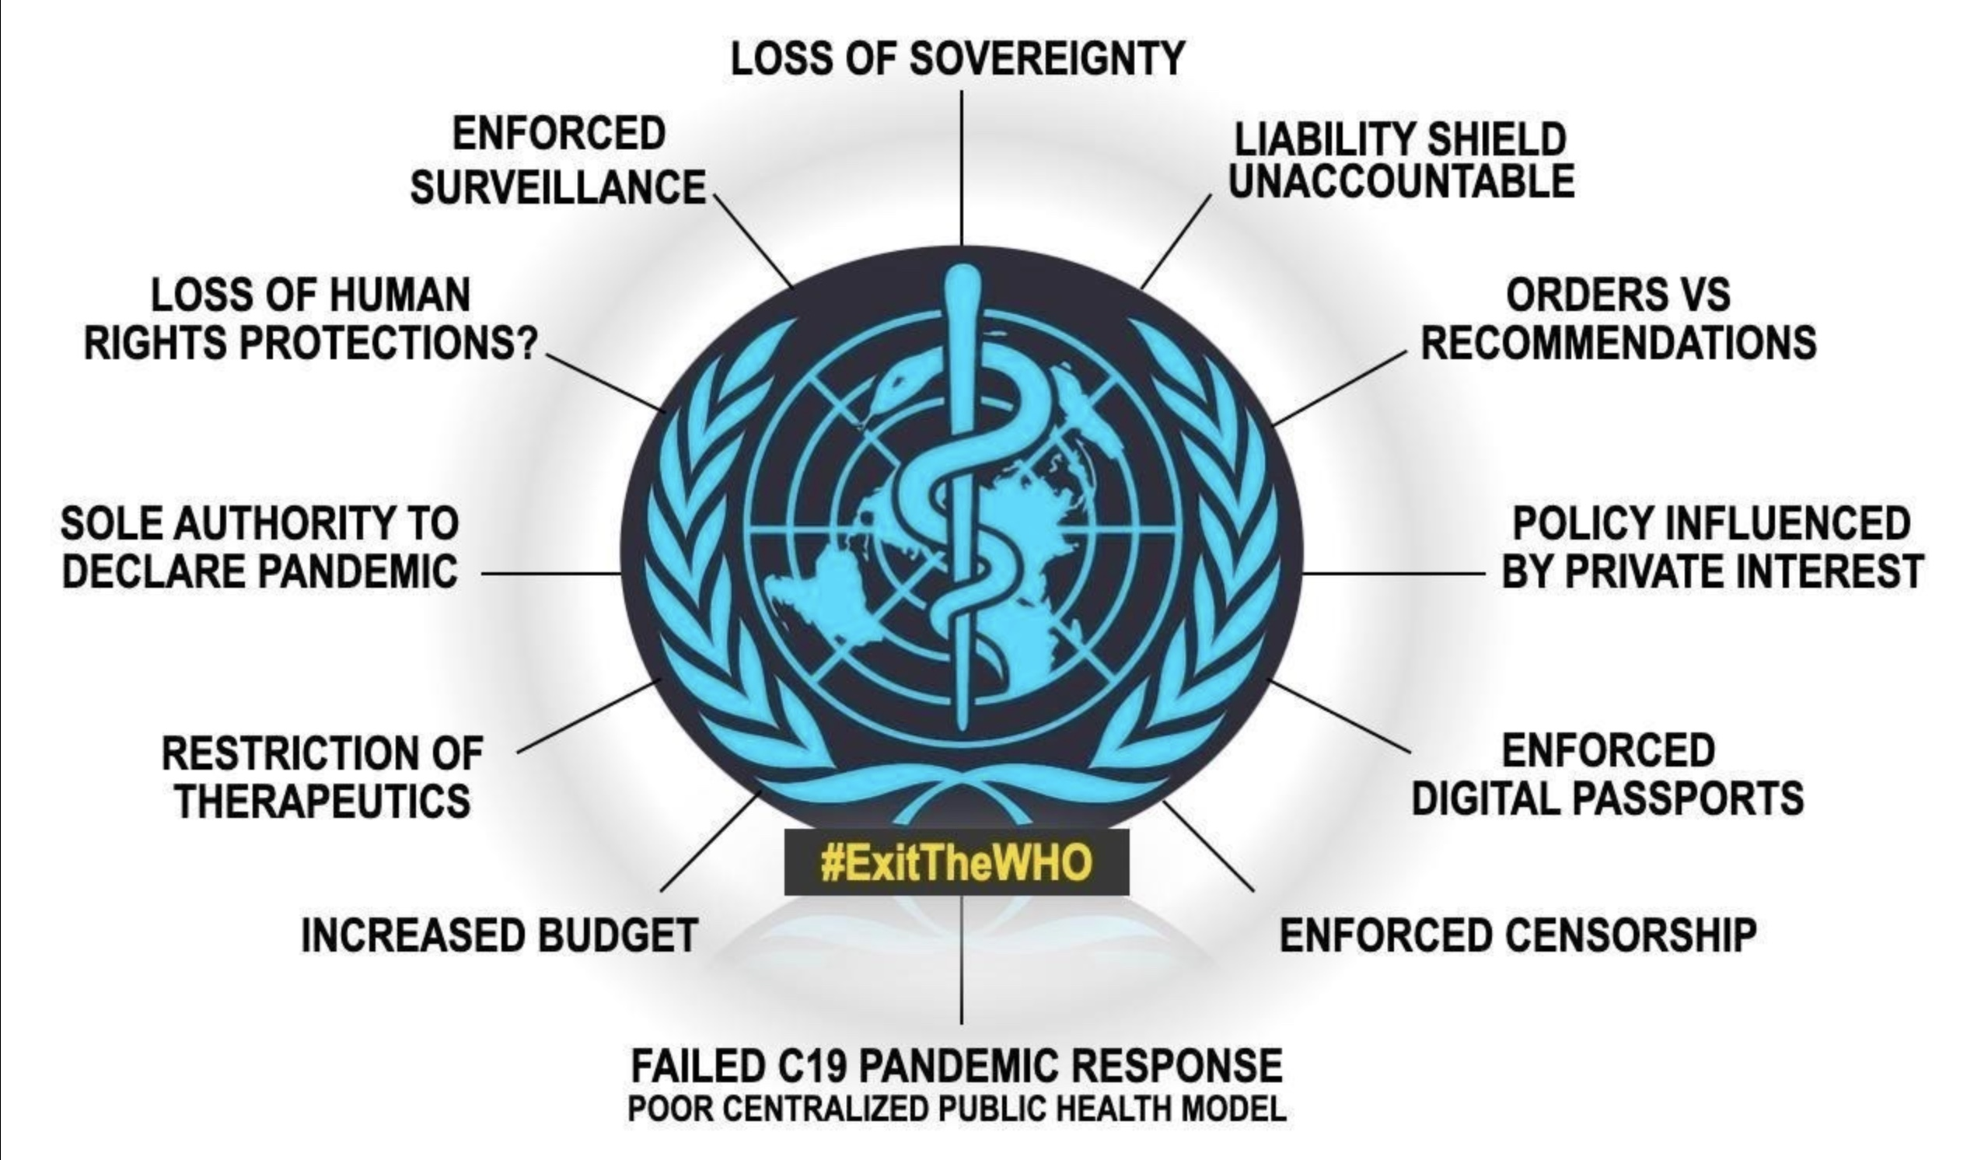

Slide 2
I want to tell you three things today Meryl Nass, M.D.
If the WHO really wanted to solve the problem of pandemics and biological warfare, it could but it didn't: strengthened the biological weapons convention of 1972, banned so-called gain-of-function research, and not incentivize the search for, sharing, and research into PPPs
The WHO is not an honest broker; it repeatedly attempts to fool us
The effort to wrest sovereignty from nations under the guise of health is not simply a WHO effort: it is also the effort of the UN, the EU, the G20, the World Bank, the 2023 NDAA/ IPP

Slide 3
'Preparedness' is very risky!
CDC and USDA run a Select Agent program for selected US Potential Pandemic Pathogens
There are 200 accidents per year reported to CDC re: select agents
In 2018 alone, 173 (of 201 reported) releases led to "895 individuals [receiving] occupational health services, including medical assessments and, if needed, diagnostic testing and prophylaxis."
https://web.archive.org/web/20200410035210/https://www.selectagents.gov/resources/FSAP_Annual_Report_2018_508.pdf
Notes:
potential pandemic pathogens

Slide 11
Wednesday, 8 November, 2023 WHO Director-General's remarks at the seventh meeting of the Intergovernmental Negotiating Body – 8 November 2023 https://www.who.int/director-general/speeches/detail/who-director-general-s-opening-remarks-at-the-seventh-meeting-of-the-intergovernmental-negotiating-body---8-november-2023
"And as if the challenge was not difficult enough, we are operating amid a torrent of fake news, lies, conspiracy theories and mis- and disinformation.
There are those who say – whether they believe it themselves or not – that the accord will cede sovereignty to WHO; that it will give the WHO Secretariat power to impose lockdowns or vaccine mandates on countries, and other nonsense.
You know and we know that the agreement will give WHO no such powers.
We need your support to put this nonsense to rest.
We need your support to counter these lies, by speaking up at home and telling your citizens that this agreement will not, and cannot, cede sovereignty to WHO. Period."

Slide 14
